Slide 1
Module 1: Overview of Problem Solving
Unit 1: Concept definition of algorithm and its trace in history
COS 102: INTRODUCTION TO PROBLEM SOLVING (3 UNITS)

Slide 2
Learning Objectives:
What is algorithm?
Demonstrate a clear understanding of the concept of algorithm in computer science.
Demonstrate the knowledge of algorithm evolution in science
Informally, algorithm is simply a method of solving problem which can be implemented on a computer.

Slide 3
Concept definition of algorithm
The concept definition of algorithm has come to be accepted as: set of step-by-step instructions for solving a well defined problem which takes allowable inputs to produce desired output.
The formal and the most acceptable definition of algorithm outlines its characteristics.
In other words, an algorithm consists of a set of unambiguous instructions that take one or more acceptable inputs to produce desired output.

Slide 4
The concept definition of algorithm emphasize that an algorithm must consists of:
It produces desired output based on the input provided. If wrong input is provided, algorithm will not give correct output
Set of instructions that can be followed, typically by a computer when implemented in computer language.
The instructions required to solve the problem should be stated explicitly. In fact, if a problem solver cannot express the instruction clearly, the algorithm will not be useful to solve the problem.
Algorithm takes acceptable data as input.

Slide 5
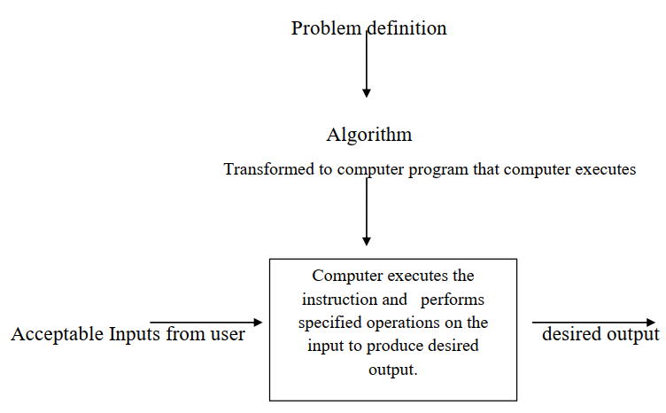
Simply we can depict the concept of algorithm as shown in figure 1.
Fig. 1: Shows the Concept of algorithm

Slide 6
The trace of algorithm in history
Al-Khwarizm is a mathematician whose works introduced Arabic numerals and algebraic concepts to Western mathematics.
The term algorithm has no root meaning. According to the American Heritage Dictionary, it is derived from the name of Muhammad ibn Musa al-Khwarizm (780A.D-850A.D).
The word “algebra” stem from the title of his book Kitab al jabr wa’l-muq’abala.

Slide 7
Problem 1
Consider a problem to find the largest of three numbers.
Let’s look at some basic application of algorithm to problems in our daily life .
Almost anyone can immediately tell which is the largest, but many cannot explain the steps they followed to arrive at it.
Most people will exclaim, “I just know it!”.

Slide 8
The algorithm for solving Problem 1 is stated below:
However, an algorithm approach desires the steps to be clearly and unambiguously stated. This is what separate algorithm from ordinary human intuition, as human intuition is an impression that something might be the case.
Step 1: Enter the three numbers say a,b,c.
Step 2: If a>b then go to step 3 else go to step 4
Step 3: If a>c then a is largest go to step 5 else c is largest go to step 5
Step 4: If b>c then b is the largest.
Step 5: Stop

Slide 9
Problem 2
Step 1: n = read input from user for list of n
Step 2: sum = 0
Step 3: i = 0
Step 4: while i < n {
Step 5: number = read input from user
Step 6: sum = sum + number
Step 7: i = i + 1 }
Step 8: mean = sum / n
Finds the mean of the sum of n set of numbers
Input: n numbers items
Output: The arithmetic mean of the numbers
The algorithm for solving Problem 2 is stated as follows:

Slide 10
• A cooking recipe booklet
• The rules of how to play a game
• DVD player instructions
• Description of a martial arts technique
Directional maps for driving from point A to B
• A car repair manual
Other examples of algorithms we interact with in our day to day life include but not limited to the following:

